Slide 1

ANALYSIS
AISHWARYAA A | MBE 10 |

Slide 2

INTRODUTION
Myntra is a leading Indian e-commerce platform focused on fashion and lifestyle products. Launched in 2007, it initially started as a personalized gift store before pivoting to apparel.
Myntra has been brought by Flipkart for 200crores In 2014 .
The target market they focus are Fashion-conscious, medium-income, young online shoppers looking for the best deals and good quality products.
Myntra has a strong social media presence on Facebook, Google+, Twitter and Pinterest with over one million fans on Facebook.
Myntra does product plugs, fashion stories and give out fashion tips on their social media platforms that are relevant for the audience and can help them make a purchase decision.
These tools help them to engage and interact with audience, collect their feedback and share fashion tips with customers.

Slide 3
Founding: In 2007, Mukesh Bansal, Ashutosh Lawania, and Vineet Saxena founded Myntra to sell personalized gift items
Becoming a fashion and lifestyle retailer: In 2011, Myntra began selling fashion and lifestyle products
Joining the Flipkart Group: In 2014, Myntra became part of the Flipkart Group.
Going app-only: In 2015, Myntra became an app-only platform.
Launching Try & Buy: In 2016, Myntra launched its Try & Buy feature
Partnering with the Ministry of Textiles: In 2017, Myntra partnered with the Ministry of Textiles to promote the handloom industry.
Myntra onboarded 50 international brands on the platform in 2023 and launched a differentiated app-in-app proposition for Gen-Z Fashion, FWD, with over 500 brands.
Launching a Premium Corner in 2014, which featured collections from leading Indian fashion designers and international brands
Launching collections from fashion designers Anita Dongre, Rohit Bal, and Manish Arora
Introducing international brands Desigual and 883 Police
Partnering with Hrithik Roshan's casual wear brand HRX to manufacture and sell exclusively on Myntra
MYNTRA’S JOURNEY
2007 -2024

Slide 4
BUSINESS MODEL OF MYNTRA AND ITS KEY TO SUCCESS
Strategies that Propelled Myntra to the Forefront of Fashion E-Commerce
Focus on Niche
E-Commerce Technology
Strategic Partnerships
Acquisition by Flipkart
Myntra’s acquisition by Flipkart in 2014 for approximately $300 million marked a strategic move that amalgamated two industry giants.
Customer-Centric Approach
Model Approach that Helped it Stand Out from Competitors
Myntra's marketing strategy is a blend of innovative digital campaigns and customer-centric approaches, making it a leader in India's fashion e-commerce.
With a core audience between 18-34 years of age, it appeals to tech-savvy youth seeking vibrant, trendy, and affordable fashion.
Psychographically, their audience values the convenience of online shopping and fashion trends.

Slide 5
MARKET POSITION AND ITS GROWTH
Myntra's market share in India's fashion e-commerce market is estimated to be between 35% and 45% as of 2023.
In 2023, Myntra's operating revenue was 43.75 billion Indian rupees, which was an increase from the previous year. Myntra has over 10 million active users every month.
In 2023, over 20 million users participated in Myntra's annual sale event, the End of Reason Sale (EORS).
Myntra's marketing campaigns aim to promote a positive and inclusive fashion culture, highlighting individuality and acceptance
Over the last three months, myntra.com's global ranking has changed from 582 to 530. In INDIA it is in 101 place.

Slide 6
Myntra revenue(FY 2022 -2023)
E-commerce fashion marketplace that generates revenue from Transaction fees , Logistics services , Advertisement services ,Consultancy services
FY 2022 (REVENUE BREAK DOWN )
Operating revenue: 35.01 billion Indian rupees
Marketplace services: Over 16 billion Indian rupees
Logistics services: Over 14 billion Indian rupees
FY 2023 (Revenue breakdown)
Operating : 43.75 billion ( 25% from FY22)
Total Expenses : 5290 Cr
Demand for D2C brands: Demand for D2C brands like Rare Rabbit, Snitch, and Bewakoof is growing fast.
Demand for luxe brands: Demand for the luxe portfolio, which sells high-end brands like Hugo Boss and Guess, has seen a 150% expansion.
Monthly active users: Myntra reported a 33% surge in monthly active users in 2023.

Slide 7
STRENGTHS (S)
Brand recognition
Diverse product range
User friendly experience
Strong delivery systems
WEAKNESS (W)
Depends on discounts as it costs high normally
Global presence limited within INDIA
Various return and exchange issues may raise up
S W O R T A N A L Y S I S
OPPORTUNITIES (O)
They options are really high
Growing e commerce
Creates new categories
Technological advancements
THREATS (T)
Intense competition as they have to compete with giants
Rapid shift of customers style
Regulatory challenges

Slide 8
TECHNOLOGY UTILIZATIONS
Varieties of technologies used includes
OMNICHANNEL TECHNOLOGY :
They have over 350 brands &5,600 stories in this network across more than 140 cities.
Allow customers to have orders delivered from the nearest store.
AI skin analyzer :
for personalized shopping
cloud services to handle its data
Microsoft Azure
Amazon web services (AWS)
Cloud object storage : here it store images, videos and files also
Myntra website is built up using React.js framework
Myntra uses Druid : For real time analysis
Power bi to visualize the data aggregated by Druid

Slide 9



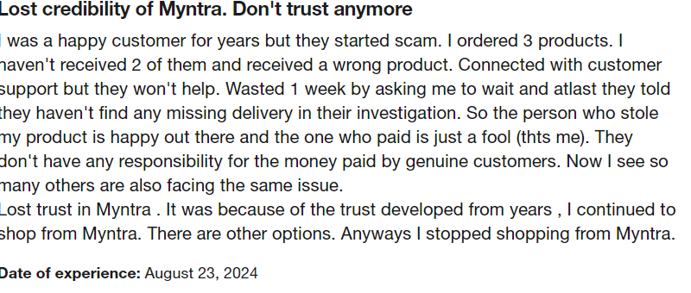
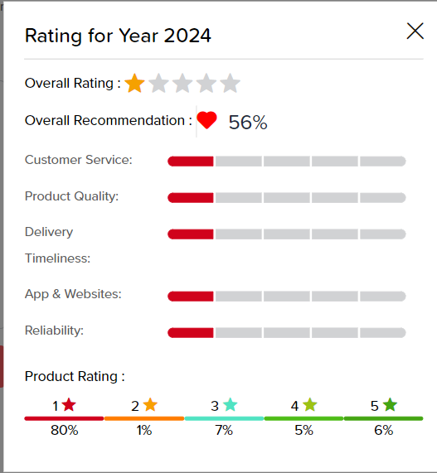
CUSTOMER REVIEW ANALYSIS
REVIEWS OF CUSTOMERS
Analyzed social media platforms (Instagram , facebook ) and review sites like (trust pilot )
On the basis of these reviews it can be categorized into various impacts like high , impact , medium

Slide 10
COMPETITOR ANALYSIS | Focus | Brand Variety | User Experience | Sales and Discounts | Return Policy
MYNTRA | Primarily fashion and lifestyle products. | Offers a wide range of local and international brands, including many exclusive collaborations. | Strong mobile app interface with personalized recommendations and user-friendly navigation. | Frequent sales events, including the "End of Season Sale" and "Myntra Fashion Superstar." | Generally user-friendly return and exchange policy.
FLIPKART | General e-commerce, including fashion. | Offers a broader range of products beyond fashion, including electronics and home goods. | Robust platform but less specialized in fashion than Myntra. | Hosts major sales events like "Big Billion Days" which include fashion deals. | Similar return policies, but may vary across product categories.
AMAZON FASHION | Fashion as part of a larger e-commerce ecosystem. | Huge selection, from high-end to budget-friendly brands. | Comprehensive filtering options, but can be overwhelming. | Regular discounts and promotions, especially during major sales events. | Generally flexible return policies, with options for prime members.
AJIO | Fashion and lifestyle, part of Reliance Industries. | : Emphasis on contemporary and trendy styles, with a mix of local and international brands. | Trendy layout and engaging content but can be less intuitive than Myntra. | Regular sales and offers, often with unique themes. | Competitive return policy, often praised for customer service.

Slide 11
STRATEGIC RECOMMENDENDATIONS
They can enhance customer experience by implementing augmented reality (AR) that allows them virtually try on clothes which can increase the sales
Exclusive collections like limited edition can be created which can increase the traffic in Myntra
Try to increase eco friendly products and recycling programs
Try to decrease the delivery charge as it is the main reason that blocks the sales.
Must have 24/7 customer support as in some cases it is lagging in .
By trying these recommendations it can help Myntra not only strengthen its current position but also pave the way for sustainable growth in the competitive e-commerce landscape.

Slide 12
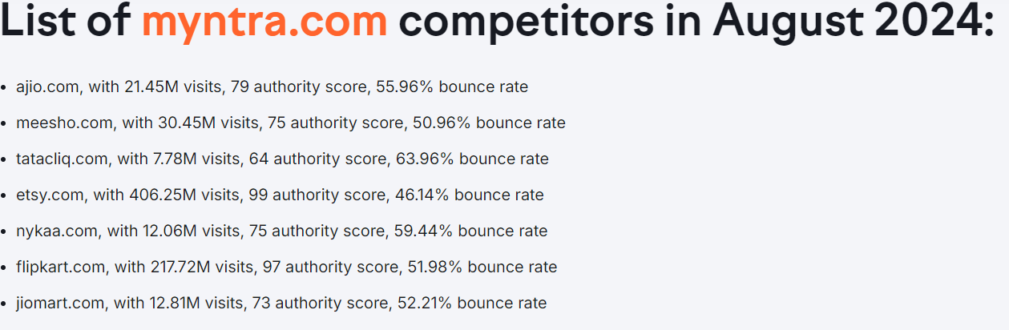
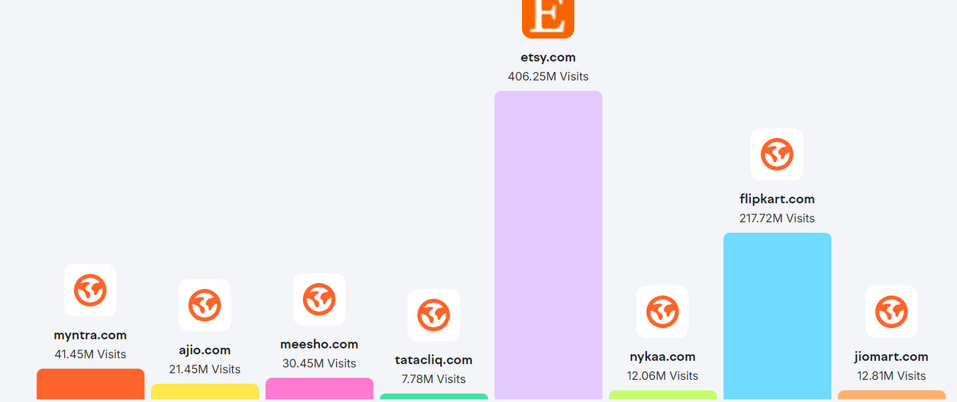
MYNTRA COMPETITORS AS OF AUG 2024
NEW COMPETITORS OF MYNTRA INCLUDE ShopLoom, Clozet and Giftosky.
Comparison of monthly visits of Myntra V/S competitors, Aug 2024

Slide 13
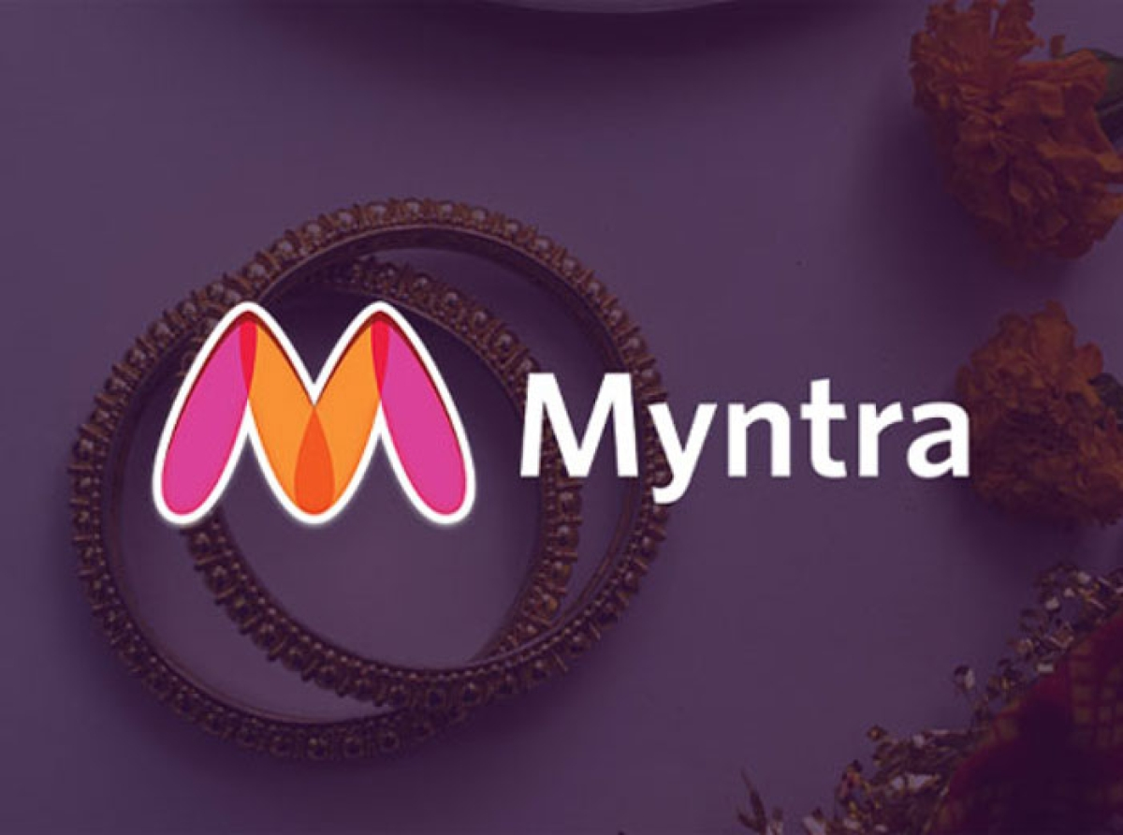
Myntra Big Fashion Festival. India's Biggest Fashion Dhamaka . Don't Waste Time
Be Extraordinary Every Day !!!!!
THANK YOU !
GO FOR IT ..

